Slide 1
Trainvasion Character Mechanics

Slide 2
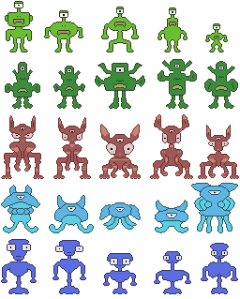
Enemy Characters

Slide 3

Enemy Mechanics
This alien species has green skin, two legs and arms, a mouth, nose, ears and one eye.

Slide 4

Enemy Mechanics
This alien species has dark green skin, two legs and no arms, a mouth, nose, ears, one eye, and two antennas.

Slide 5

Enemy Mechanics
This alien species has red dry skin, two legs and arms, a mouth, ears and three eyes.

Slide 6

Enemy Mechanics
This alien species has wet blue skin, no legs and multiply tentacles, a mouth, ears and one eye.

Slide 7

Enemy Mechanics
This alien species has dark blue skin, one legs and two arms, a mouth, ears and two eyes.

